Slide 1
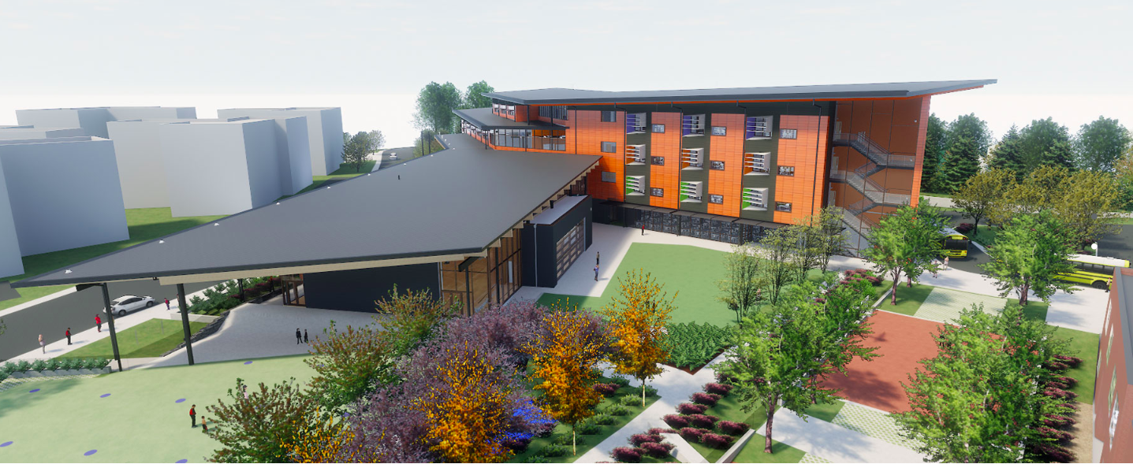
Welcome to Back to School Night 2019
Welcome to Back to School Night 2019
Alice West Fleet Elementary School
Kindergarten at Alice West Fleet Elementary

Slide 2
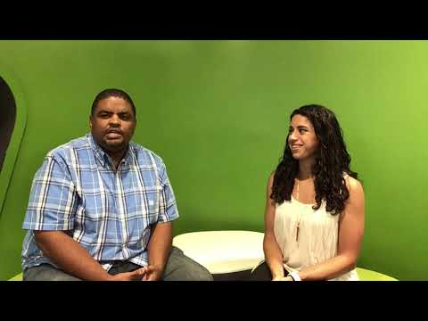
Greetings from Fleet Administrators
https://www.youtube.com/watch?v=KXvkOHUV848

Slide 3
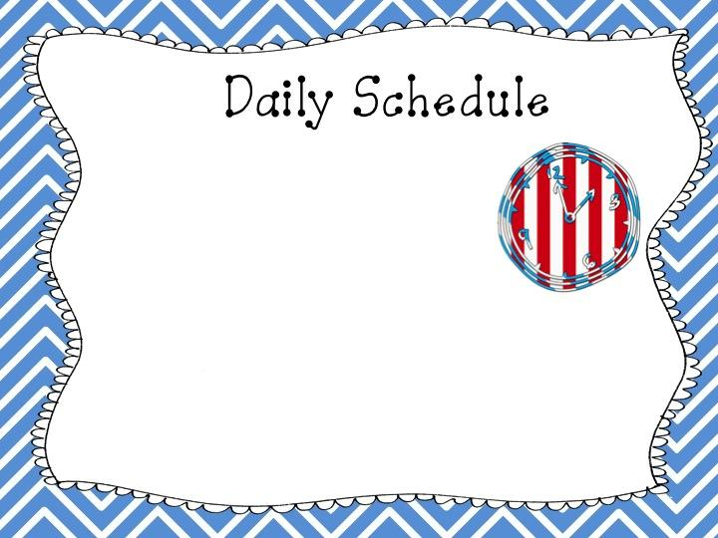
Morning: Morning Meeting, Language Arts, Movement Breaks
Lunch & Recess: 11:15 – 12:15
Afternoon: Math, Snack, Specials, Content (Social Studies & Science)

Slide 4
Specials
Library
Art
Music
Spanish
P.E.

Slide 5
Phonemic Awareness & Phonics Instruction
Shared and Guided Reading
Poems, Rhymes, Songs
Concept of Print
Fiction/Nonfiction Texts
Upper and Lowercase Letters
First and Last Names
Lucy Calkins- Writers Workshop Curriculum
Handwriting Without Tears (letter formation)
Recognize Upper and Lowercase Letters
Beginning/ending/medial sounds in words
Labeling pictures
Quick words
Write for a variety of purposes

Slide 6
Numbers 1-100
More, Fewer, Same
Graphing
Comparing sets
Before/After
Part/Whole relationships
Counting forwards and backwards
Counting by10’s
Coins/Measurement
Seasons
Habitat
Five Senses
Matter
Magnetism
Plant/Animal Life Processes

Slide 7
Good citizenship
Getting to Know: You/Me/School/Family/Rules
Holidays
Past and Present
Identify State and USA
Community Helpers
Maps and Globes

Slide 8
Birthdays
You are welcome to bring in small treats for your child on your child’s birthday
We can celebrate it during a 20 minute time period between 12:15 pm to 2 pm
Please contact and schedule a time with your child’s teacher

Slide 9
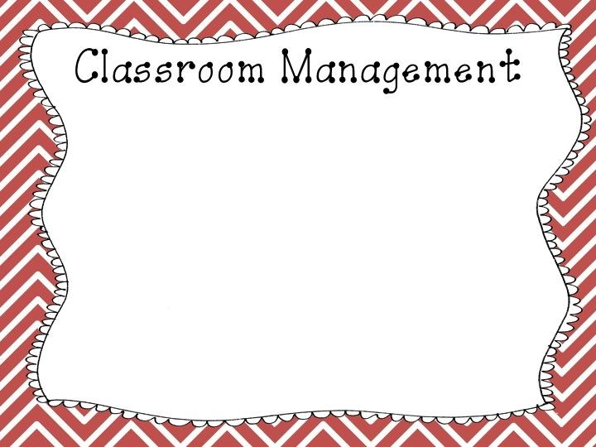
We review rules and reasons behind them in the beginning of the year.
Students are aware of consequences for their behavior.
Lots and lots of modeling
We come up with a Classroom Contract as a class. The students come up with the rules.

Slide 10
We will try to take at least 2 field trips this year. As we get closer to the dates we will let you know about volunteering opportunities.

Slide 12
Parentvue
ParentVue
For the 2019-20 school year, Arlington Public Schools (APS) will implement a new annual online verification process for
updating and maintaining accurate student information.
In ParentVue, you will be able to update contact information & find the latest information about your child’s attendance and scheduling, as well as standards-based progress reports.
Once you have activated your ParentVue account, you can sign in using your username and password at https://vue.apsva.us
Laptops will be set up and personnel will be available to assist you with setting up ParentVue accounts Thursday, August 29 from 6:00-8:00 pm in the Cafeteria, or Friday, August 30, from 9:00-11:00 am in the cafeteria.
Stay tuned for more dates in the future.

Slide 13
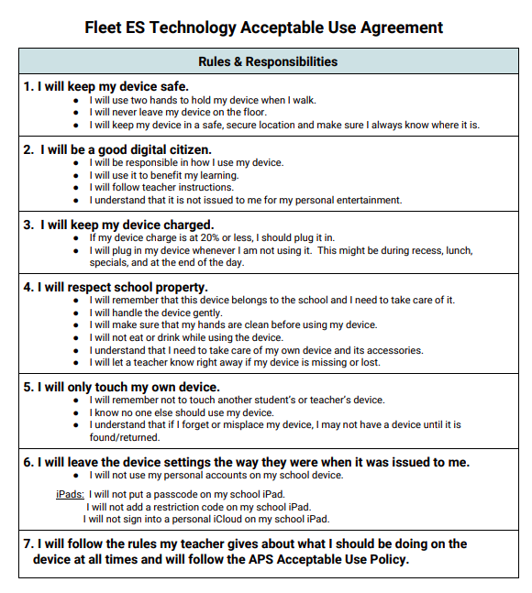
Technology- AUP
ParentVue
Arlington Public Schools School Board Policy I-9.2.5.1, Acceptable Use Policy, governs the use of technology by students in schools. At Fleet, we use our own technology agreement to outline student expectations for handling of their device that adds on to the basic principles of the Acceptable Use Policy (AUP).
All students in grades Pre K through 5 will have a lesson on the acceptable use of technology whether they have their own device or not
APS has a 1-to-1 iPad program for grades 3-5 in elementary school. Students and parents of students in these grades should sign the APS Acceptable Policy. Students will not be allowed to use a device until this document is signed.
Parents, please read and sign the AUP document from APS that is on your child’s desk tonight and leave it with your child’s teacher.

Slide 14
Parent Involvement/ Opportunities to volunteer
Join the PTA / Be a Room Parent (The PTA table is set up in lobby right now)
Keep in touch with your child’s teacher
Attend Parent-Teacher conference(s)
Talk to your child about what he/she is learning
Volunteer to help in the classroom
Read to/with your child at home and talk about what you read together

Slide 15
Standards Based Report Cards
•Meets Standard: The student consistently demonstrates mastery of the standard.
•Approaching Standard: The student is in the process of mastering the standard.
•Developing Standard: The student demonstrates initial understanding of the standard with support.
•Insufficient Evidence: The teacher does not have evidence to determine as student’s mastery level for this skill.

Slide 16
- Check out our Twitter page for videos/photos:
twitter.com/mpourrabi
twitter.com/GlickKinder
twitter.com/mrsleeaps
twitter.com/ewelllovekinder
___________________________

